Slide 1

类器官研究中的细胞因子
选择与应用
李田子, Ph.D.
高级产品经理
北京义翘神州科技股份有限公司
09-2024
义翘神州

Slide 2

CONTENT
1
类器官培养的关键细胞因子“配方”
2
经类器官培养验证的细胞因子
义翘神州

Slide 3
01
类器官培养的关键细胞因子“配方”
义翘神州

Slide 4
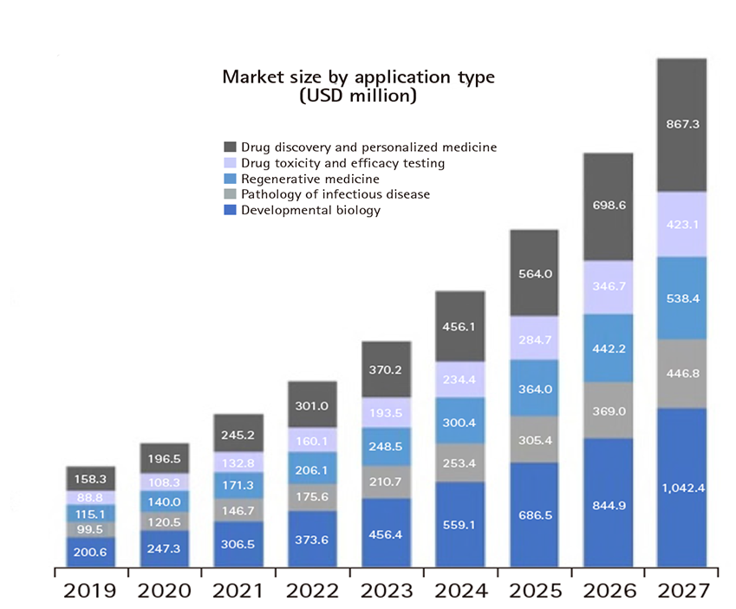
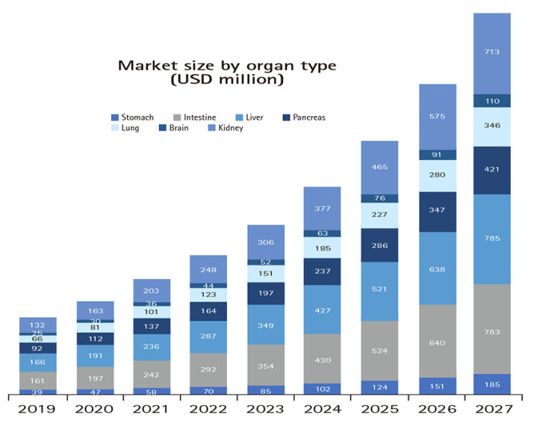
类器官研究-市场情况
√
√
√
√
√
终端客户 | 可能应用
Biotchenology & Pharmaceutical industries | 主要用于建立类器官模型和类器官芯片以及基于模型的药物开发，药敏反应等
Academic & Research institutes
Hospitals & Diagnostic Centers
Homan. doi.org/10.1002/adbi.202200334
Hanbyeol Lee; et al. doi.org/10.51335/organoid.2021.1.e11.
Source: www.gminsights.com
义翘神州

Slide 5
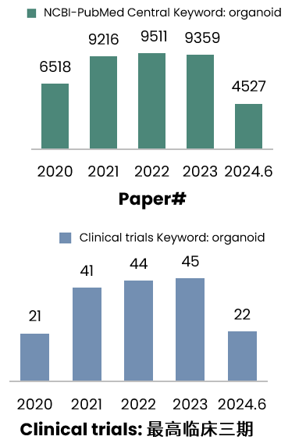
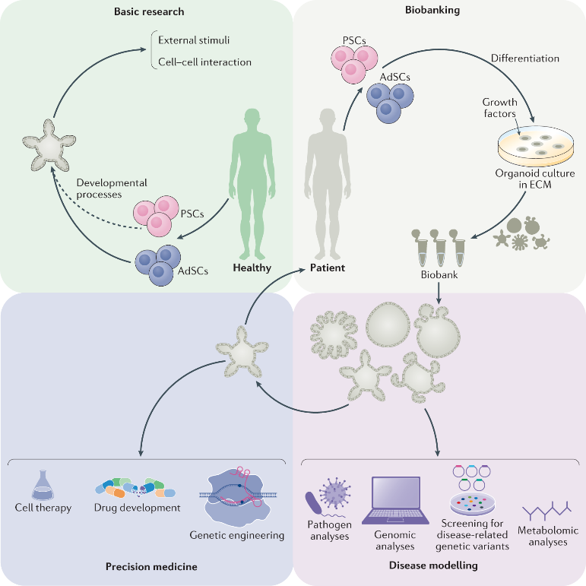
类器官研究-研究进展和潜在应用
Basic research
Biobanking
Precision medicine
- Response to drugs
- Resources for regenerative medicine coupled with genetic engineering
Disease modeling
- Mechanisms of human diseases
- Inheritable genetic disorders
Drug-screening analyses
Source: NCBI-PubMed Central
https://ClinicalTrials.gov
Jihoon Kim; et al. doi.org/10.1038/s41580-020-0259-3.
义翘神州

Slide 6
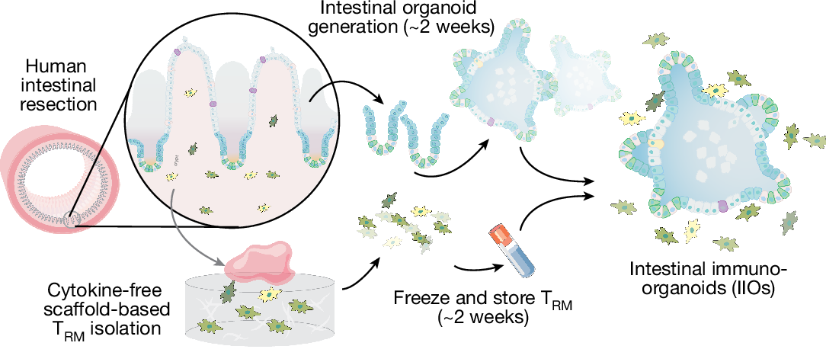
类器官研究-创新模型
2024年8月14日, Nature刊发了一篇关于具有自体组织驻留免疫系统的肠道类器官（IIOs）模型
传统的肠道类器官主要关注上皮细胞的分化和功能，而未将免疫系统纳入其中
炎症性肠病（IBD）和癌症等疾病中，免疫反应会影响疾病进展和治疗效果
文献中建立的类器官可能能更准确地表现出肠道病生理的状态
Schematic overview of establishment of autologous IIOs.
Timothy Recaldin et al. doi.org/10.1038/s41586-024-07791-5.
义翘神州

Slide 7
肠道类器官-药物筛选
应用场景 | 疾病 | 研究题目 | 临床#
药物筛选 | 结直肠癌 | Prospective Observation on the Accuracy of in Vitro Screening of Colorectal Cancer Chemotherapy Drugs Based on Organoids-on a-chip | NCT04996355
 |  | The Culture of Advanced/Recurrent/Metastatic Colorectal Cancer Organoids and Drug Screening | NCT05304741
 |  | Patient-derived Organoids of RAS/RAF Wild-type Metastatic Right Colon Cancer to Test the Sensitivity and Clinical Consistency of Combined Treatment of Cetuximab. | NCT04906733
 |  | A Prospective Multicenter Randomized Controlled Trial of the Clinical Efficacy of Neoadjuvant Therapy Based on Organoids Drug Sensitivity Versus Empirical Neoadjuvant Therapy in the Treatment of Advanced Rectal Cancer | NCT05352165
Qinying Wang; et al. doi.org/10.1038/s41392-022-01194-6.
义翘神州

Slide 8
肠道类器官培养-主要细胞因子
激活小肠隐窝的Wnt信号
隐窝数量增多
RSPO-1
Noggin
肠道类器官
EGF
Wnt
协助小肠增殖
维持肠道干细胞
Toshiro Sato; et al. doi.org/10.1053/j.gastro.2011.07.050.
义翘神州
Notes:
R-spondin-1 is a marker for intestinal stem cells。
Second, epidermal growth factor (EGF) signaling is associated with intestinal proliferation.¹³
Third, transgenic expression of Noggin induces expansion of crypt numbers.¹⁴
Fourth, isolated intestinal cells undergo anoikis outside the normal tissue context.¹⁵
Because laminin (α1 and α2) is enriched at the crypt base,¹⁶
we explored laminin-rich Matrigel to support intestinal epithelial growth.
Wnt:maintain intestinal stem cells

Slide 9
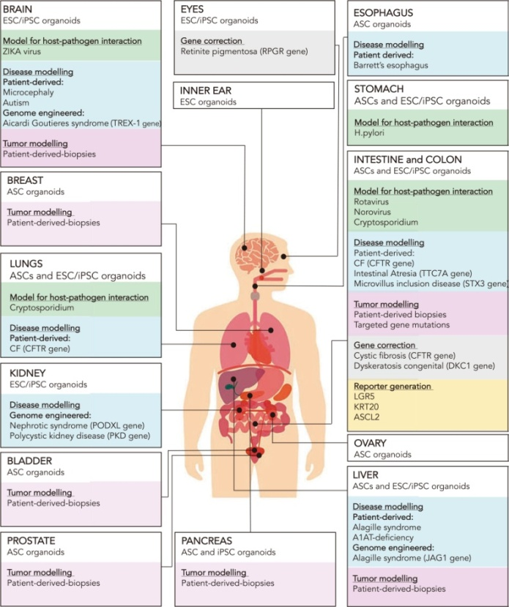
类器官研究-相关细胞因子
BRAIN
EYES
ESOPHAGUS
Brain | Breast | Lung | Prostate | Pancreatic | Heart | Intestinal | Gastric | Liver
 | EGF |  | EGF | EGF |  | EGF | EGF | EGF
FGF2 | FGF2 | FGF2 | FGF2 | FGF2 | FGF2 |  |  | FGF2
 |  | FGF7
 |  |  |  |  |  |  |  | TGFB1
 | FGF10 | FGF10 | FGF10 | FGF10 | FGF10 |  | FGF10 | FGF10
NOG | NOG | NOG | NOG | NOG |  | NOG | NOG | NOG
 |  | INHBA | INHBA |  | INHBA |  |  | INHBA
 |  |  |  |  |  |  |  | HGF
 | RSPO1 | RSPO1 | RSPO1 | RSPO1 |  | RSPO1 | RSPO1 | RSPO1
 |  |  |  |  |  |  |  | OSM
DKK1 |  |  |  |  |  |  |  | DKK1
GDNF
 |  |  |  |  | LIF
INNER EAR
STOMACH
INTESTINE and COLON
BREAST
LUNGS
KIDNEY
OVARY
BLADDER
LIVER
PROSTATE
PANCREAS
Figure. Human-derived organoids
Benedetta Artegiani; et al. doi.org/10.1093/hmg/ddy187.
义翘神州

Slide 10
02
经类器官培养验证的细胞因子
义翘神州

Slide 11
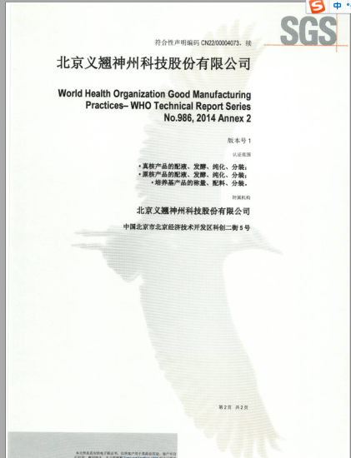

细胞因子产品线特点概述
250+细胞因子类分子，800+细胞因子类产品
按照ISO9001:2015和ISO13485:2016质量管理体系要求进行生产
涉及免疫细胞培养、干细胞研究、类器官培养等热门应用领域
覆盖生长因子、趋化因子、干扰素、白介素、淋巴因子等
严格质控造就更优细胞活性
高批间一致性
高纯度
（20+ GMP级细胞因子）
GMP认证书
2024年值得关注的生长因子供应商
义翘神州

Slide 12
细胞因子产品设计
种属多：Human、Mouse、Monkey等，尽可能满足不同的动物实验模型
倾向于无标签或者小标签
真核或者原核表达系统
低内毒素
活性有竞争力
应用场景数据展示
义翘神州

Slide 13
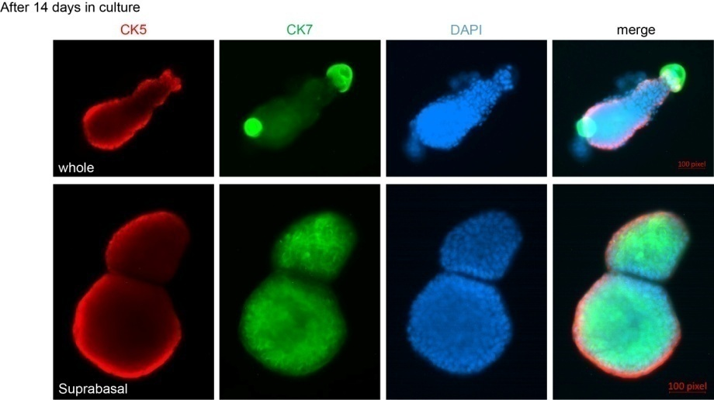
细胞因子产品设计
多种属：Human、Mouse、Monkey等，尽可能满足不同动物实验模型的需求
小鼠膀胱类器官培养
经过14天的培养：
Mouse Bladder Organoids after 14 days in culture 25 ng/mL of Recombinant Mouse KGF/FGF-7 Protein(50394-M07E) was used for 2 weeks in BME submerged in mouse bladder media.
Data provided by Dr. Yin at Washington University, St. Louis, MO.
义翘神州

Slide 14
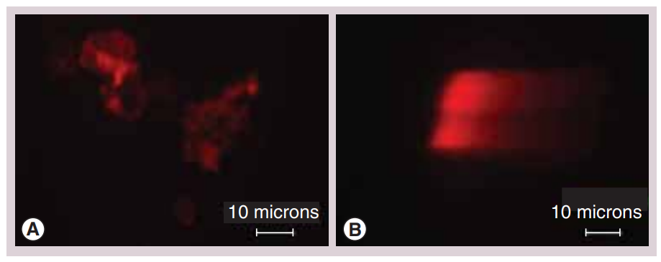
细胞因子产品设计
低内毒素
Comet assay showing the degree of apoptosis induced in control and lipopolysaccharides-treated embryoid bodies.
LPS处理的胚状体中胚层的生物标志物会消失且不能分化成有功能的成骨细胞
LPS处理的胚状体会出现凋亡的现象
Panel (A) shows normal 5-day-old embryoid bodies and (B) shows 5-day-old embryoid bodies exposed to lipopolysaccharides for 48h. Picture were acquired at 10× magnifications.
Kavitha Sivasubramaniyan; et al. doi.org/10.2217/17460751.3.1.23.
义翘神州
Notes:
脂多糖
用胚状体作为体外模型去检验格兰仕阴性菌对于胚胎发生过程中胚系的诱导的影响
LPS (also termed endotoxin) is the major component of the outer membrane of Gram-negative bacteria：LPS（也称为内毒素）是革兰氏阴性菌外膜的主要成分
成骨细胞

Slide 15

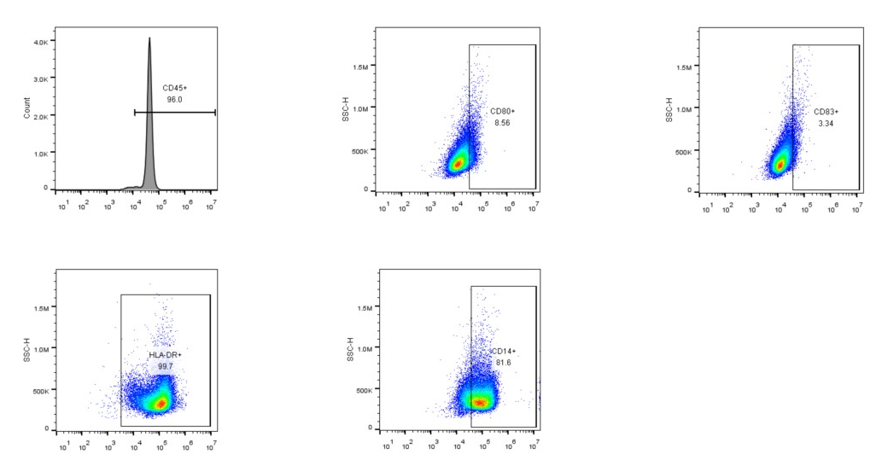
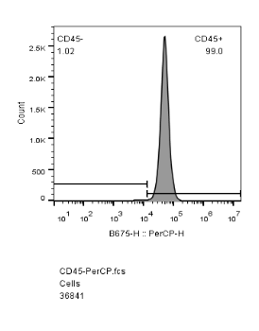
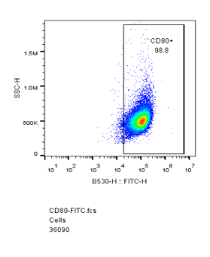
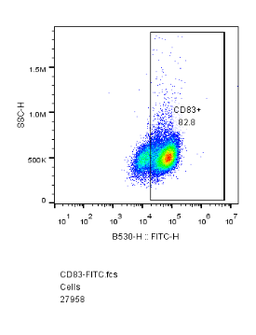
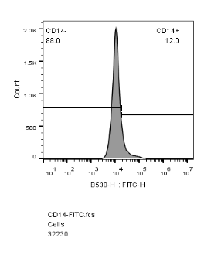
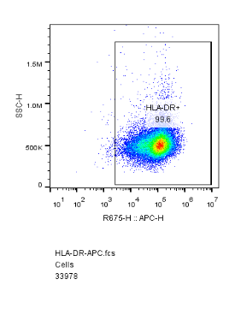
细胞因子产品设计
应用场景数据展示-1：免疫细胞应用场景
Immature DCs
Mature DCs
CD14+ monocytes were differentiated into immature DCs by GM-CSF(GMP-10015-HNAH) and IL4(GMP-11846-HNAE) for 6 days.
DCs were matured by TNF(GMP-10602-HNAE) for 2 days.
义翘神州

Slide 16
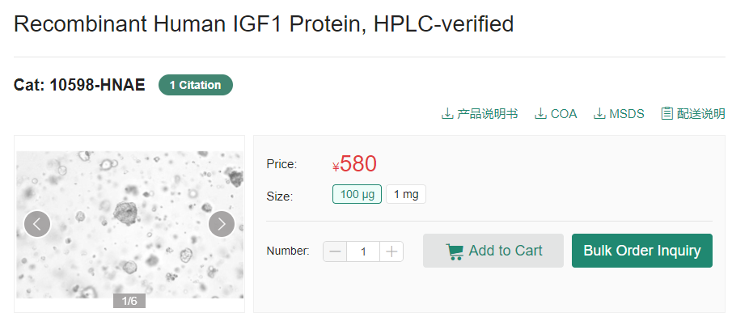
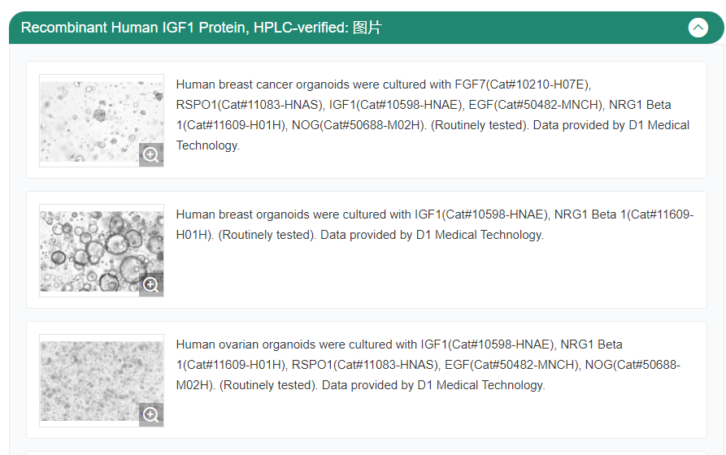
细胞因子产品设计
应用场景数据展示-2：类器官应用场景
点开产品详情页：
产品详情页下拉：
义翘神州

Slide 17
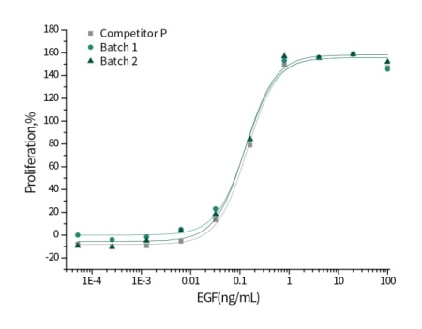
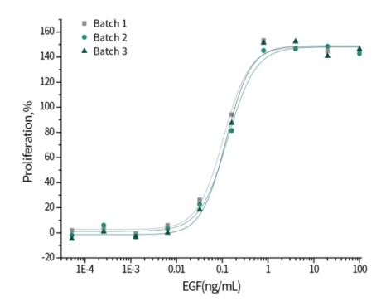
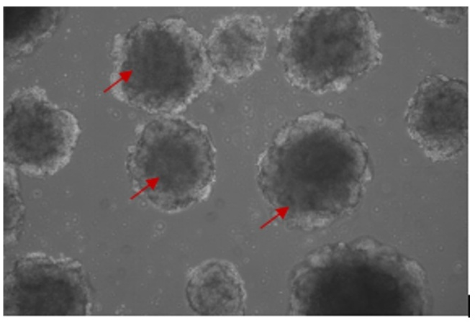
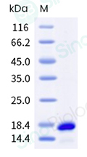
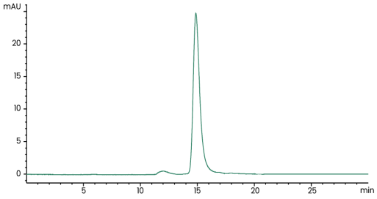
类器官培养相关产品数据
EGF (Cat#: 10605-HNAE)
活性比较数据
批间一致性数据
血管类器官培养
国外知名品牌
义翘神州批次1
义翘神州批次2
义翘神州批次1
义翘神州批次2
义翘神州批次3
Measured in a cell proliferation assay using Balb/C3T3 mouse embryonic fibroblasts.
FGF2 (Cat#: 10014-HNAE)
VEGF165 (Cat#: 11066-HNAH)
高纯度（≥ 95%）
高纯度（≥ 95%）
iPSC-derived human vascular organoids (Day 7) were cultured with FGF2(10014-HNAE), VEGF165(11066-HNAH), EGF(10605-HNAE).
Red arrows represent vascular organoids. Image taken at 10x magnification. Data provided by Dr. Wang at School of Basic Medical Science Peking University
义翘神州

Slide 18
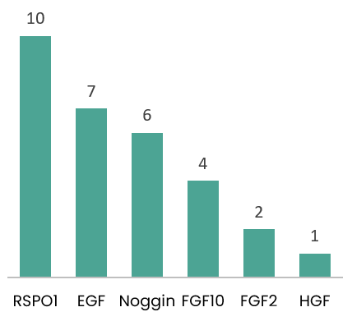
类器官相关产品的引用文献
2022~2024
类器官相关引用文献数量
文献名称(年份)-类器官类型 | 影响因子 | 所用货号
Human early syncytiotrophoblasts are highly susceptible to SARS-CoV-2 infection(2022)-滋养层类器官 | 11.7 | 10463-HNAS(HGF); 11083-HNAS(RSPO1)
Single-cell transcriptomics reveals cell atlas and identifies cycling tumor cells responsible for recurrence in ameloblastoma(2024)-成釉细胞瘤类器官 | 10.8 | 10014-HNAE(FGF2)
CUL4B-DDB1-COP1-mediated UTX downregulation promotes colorectal cancer progression(2023)-结直肠癌类器官 | 9.4 | 11083-HNAS(RSPO1); 50688-M02H(NOG); 50482-MNCH(EGF); 10573-HNAE(FGF10)
Feedback activation of EGFR/wild-type RAS signaling axis limits KRASG12D inhibitor efficacy in KRASG12D-mutated colorectal cancer(2023) -结直肠癌类器官 | 6.9 | 11083-HNAS(RSPO1); 50688-M02H(NOG); 50482-MNCH(EGF)
Evaluation of B7-H3 Targeted Immunotherapy in a 3D Organoid Model of Craniopharyngioma(2022)-颅咽管瘤类器官 | 4.8 | 10605-HNAE(EGF); 10573-HNAE(FGF10)
义翘神州

Slide 19
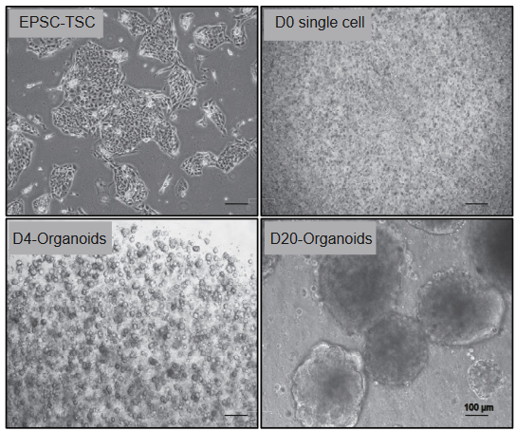
滋养层类器官培养-文献中产品应用案例
滋养层类器官
80 ng/mL Human R-spondin 1 (Sino Biological, 11083-HNAS)
培养中用到的细胞因子
50 ng/mL Human HGF (Sino Biological, 10463-HNAS)
50 ng/mL Human EGF
100 ng/mL Human FGF2
扩增潜力干细胞-滋养层干细胞来源的滋养层类器官
Degong Ruan; et al. doi.org/10.1016/j.xcrm.2022.100849.
义翘神州

Slide 20
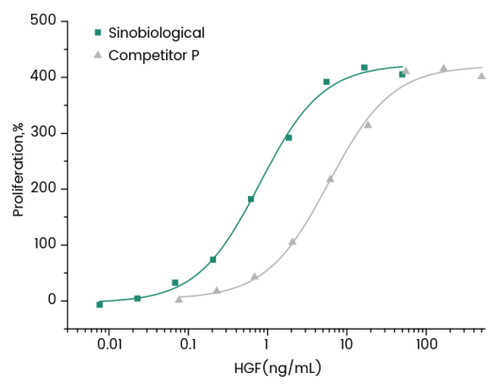
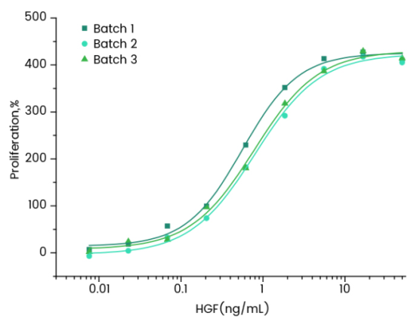
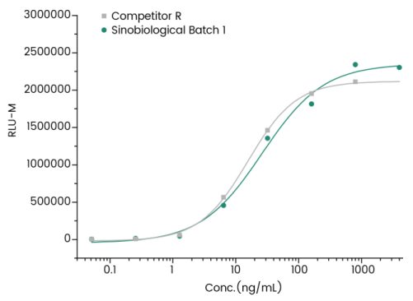
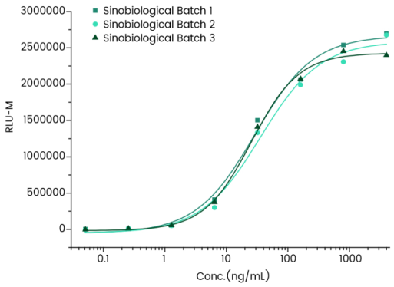
类器官培养相关产品数据
RSPO1 (Cat#: 11083-HNAS)
HGF (Cat#: 10463-HNAS)
活性比较数据
批间一致性数据
活性比较数据
批间一致性数据
义翘神州批次1
义翘神州批次2
义翘神州批次3
义翘神州
国外知名品牌
义翘神州批次1
义翘神州批次2
义翘神州批次3
国外知名品牌
义翘神州
Measured by its ability to induce activation of ßcatenin response in a Topflash Luciferase assay using HEK293T human embryonic kidney cells.
Measured by its ability to neutralize TGF-beta mediated inhibition on Mv-1-Lu cell proliferation.
义翘神州

Slide 21
肠道类器官培养-文献中产品应用案例 1
结直肠癌类器官--结直肠癌患者治疗效果的研究
结直肠癌组织分离培养
包埋在Matrigel中
接种到12孔板上
Advanced DMEM/F12 medium
培养主要组成
50 ng/mL Mouse EGF (Sino Biological, 50482-MNCH)
添加类器官培养基
每2~3天更换新鲜培养基
100 ng/mL Mouse Noggin (Sino Biological, 50688-M02H)
50 mg/mL Human R-spondin1 (Sino Biological, 11083-HNAS)
结直肠癌类器官用于：
药敏试验
药物作用机制研究
Feng et al.doi.org/10.1038/s41388-023-02676-9.
义翘神州

Slide 22
肠道类器官培养-文献中产品应用案例 2
结直肠癌类器官--疾病研究
结直肠癌组织分离培养
Advanced DMEM/F12 medium
包埋在Matrigel中
接种到48孔板上
培养主要组成
50 ng/mL Mouse EGF (Sino Biological, 50482-MNCH)
添加类包含药物的培养基
每3天更换新鲜培养基
100 ng/mL Mouse Noggin (Sino Biological, 50688-M02H)
500 ng/mL Human R-spondin1 (Sino Biological, 11083-HNAS)
结直肠癌类器官用于：
疾病研究
药物作用机制研究
100 ng/mL Human FGF10 (Sino Biological, 10573-HNAE)
Dakui Luo et al.doi.org/10.1186/s40164-023-00440-z.
义翘神州

Slide 23
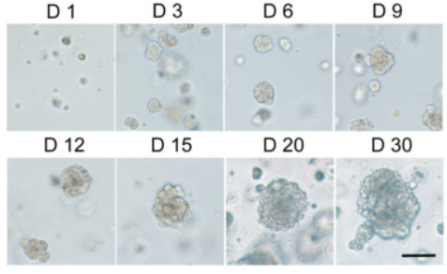
脑类器官培养-文献中产品应用案例
脑肿瘤类器官
培养中用到的细胞因子
10 ng/mL Human FGF10 (Sino Biological, 10573-HNAE)
10 ng/mL Human EGF (Sino Biological, 10605-HNAE)
不同时间点颅咽管瘤类器官的形态
Xiao-Yan Tang; et al. doi.org/10.1038/s41392-022-01024-9.
义翘神州

Slide 24
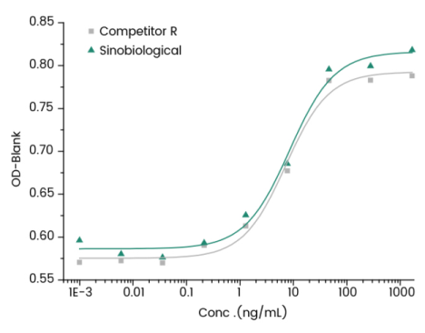
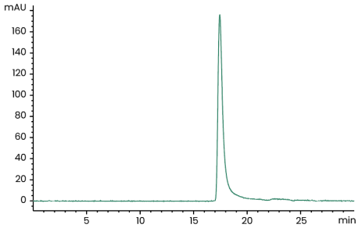
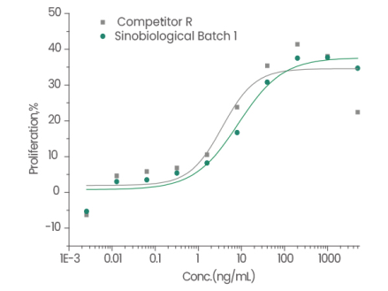
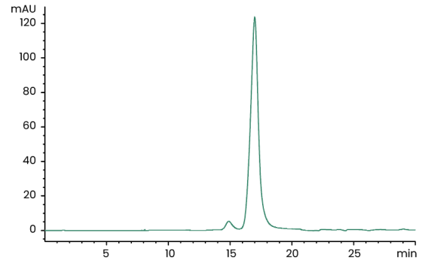
类器官培养相关产品数据
FGF10 (Cat#: 10573-HNAE)
FGF7/KGF (Cat#: 10210-H07E)
活性比较数据
高纯度（≥ 95%）
活性比较数据
高纯度（≥ 95%）
国外知名品牌
义翘神州
国外知名品牌
义翘神州
Cell proliferation assay using BaF3 mouse pro-B cells transfected with human FGFR2b.
Cell proliferation assay using BaF3 mouse pro-B cells transfected with human FGFR2b.
义翘神州

Slide 25
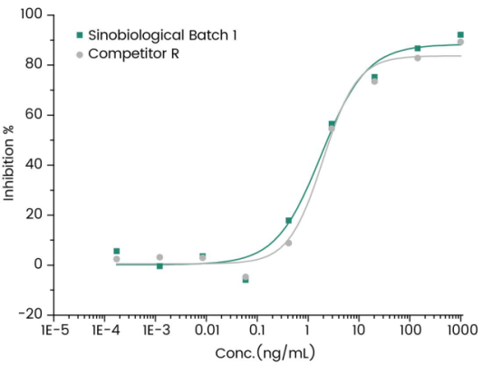
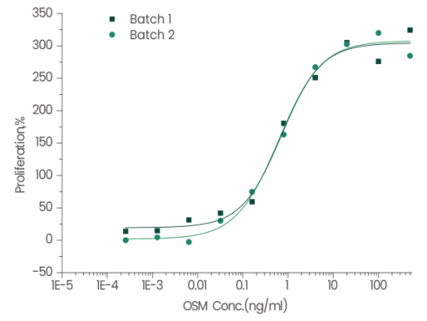
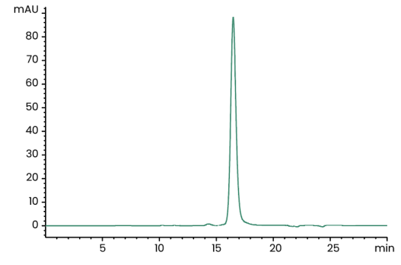
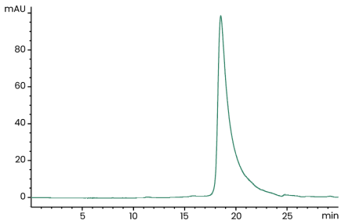
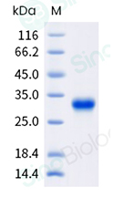
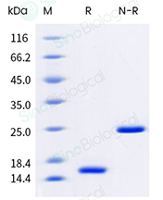
类器官培养相关产品数据
GMP级 Human Activin A
(Cat#: GMP-10429-HNAH)
GMP级 Human OSM
(Cat#: GMP-10452-HNAH)
活性比较数据
高纯度（≥ 95%）
批间一致性数据
高纯度（≥ 95%）
义翘神州
国外知名品牌
义翘神州批次1
义翘神州批次2
Inhibit proliferation of MPC-11 cells. >1000U/mg
Cell proliferation assay using TF-1 human erythroleukemic cells.
>30,000 Units/μg
义翘神州

Slide 26
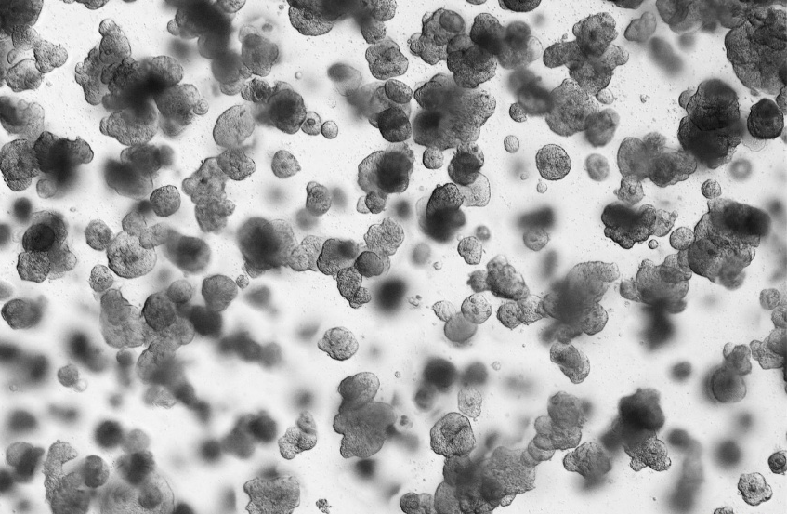
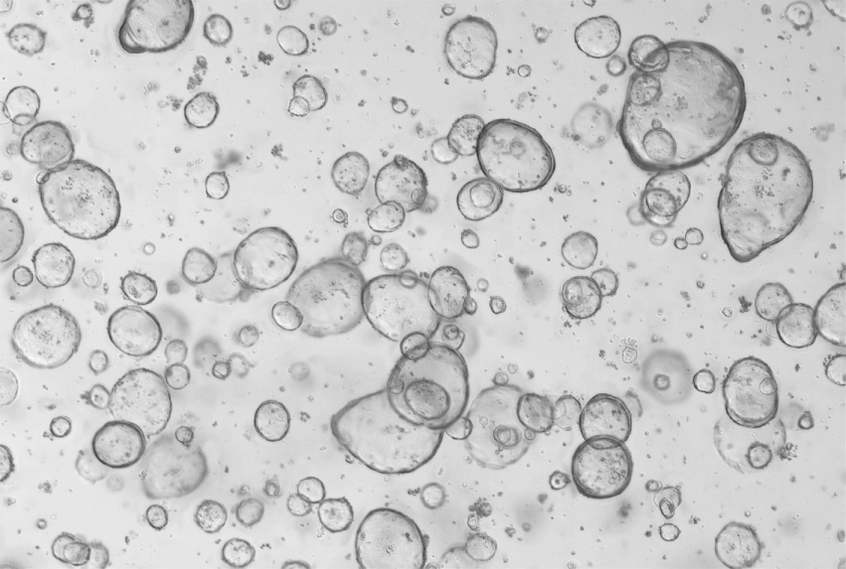
经不同类器官培养验证的细胞因子
人肠癌类器官
人结直肠类器官
Human intestinal cancer organoids were cultured with RSPO1(11083-HNAS), EGF(50482-MNCH), NOG(50688-M02H). (Routinely tested). Data provided by D1 Medical Technology
Human colorectum organoids were cultured with RSPO1(11083-HNAS), EGF(50482-MNCH), NOG(50688-M02H). (Routinely tested). Data provided by D1 Medical Technology.
义翘神州

Slide 27
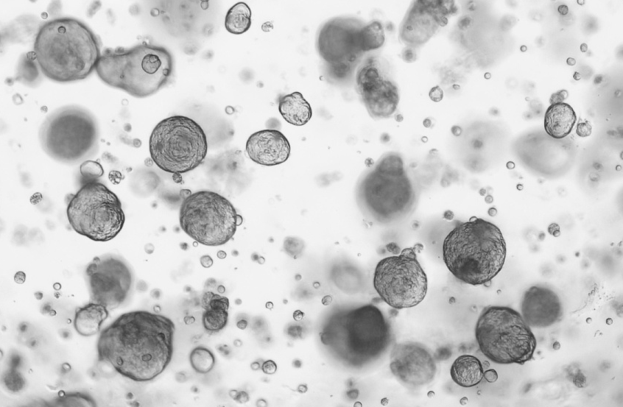
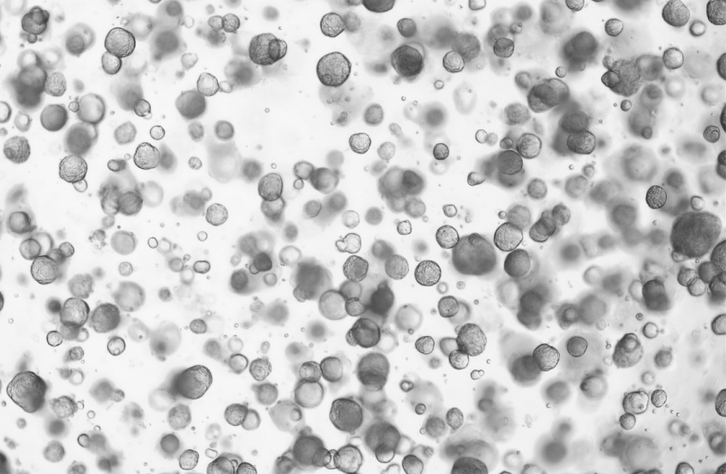
经不同类器官培养验证的细胞因子
人肺癌类器官
人肺类器官
Human lung cancer organoids were cultured with FGF2(10014-HNAE), FGF4(16043-HNAE), FGF7(10210-H07E), EGF(50482-MNCH), FGF10(10573-HNAE), NOG(50688-M02H), RSPO1(11083-HNAS). (Routinely tested). Data provided by D1 Medical Technology.
Human lung organoids were cultured with FGF2(10014-HNAE), FGF4(16043-HNAE), FGF7(10210-H07E), EGF(50482-MNCH), FGF10(10573-HNAE), NOG(50688-M02H), RSPO1(11083-HNAS). (Routinely tested). Data provided by D1 Medical Technology.
义翘神州

Slide 28
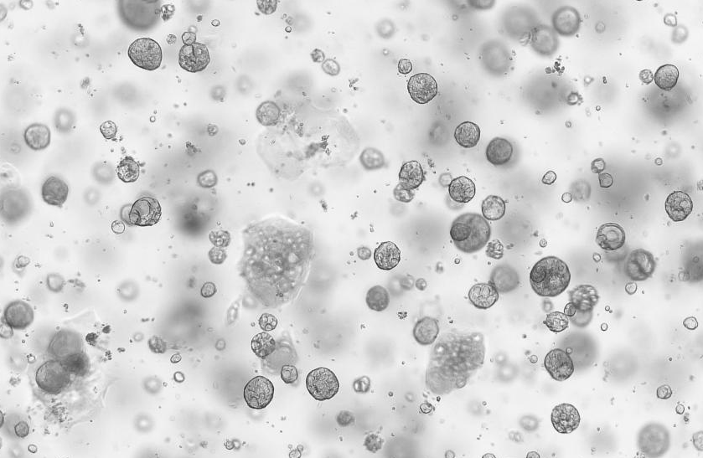
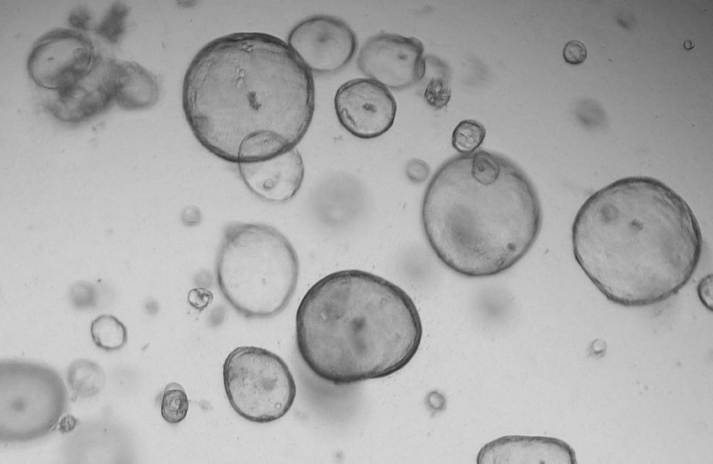
经不同类器官培养验证的细胞因子
人肝癌类器官
人胆管癌类器官
Human liver cancer organoids were cultured with FGF2(10014-HNAE), HGF(10463-HNAS), FGF7(10210-H07E), EGF(50482-MNCH), FGF10(10573-HNAE), TGFB1(10804-HNAC), NOG(50688-M02H), RSPO1(11083-HNAS). (Routinely tested). Data provided by D1 Medical Technology.
Human cholangiocarcinomas organoids were cultured with FGF2(10014-HNAE), HGF(10463-HNAS), FGF7(10210-H07E), EGF(50482-MNCH), FGF10(10573-HNAE), NOG(50688-M02H), RSPO1(11083-HNAS). (Routinely tested). Data provided by D1 Medical Technology.
义翘神州

Slide 29
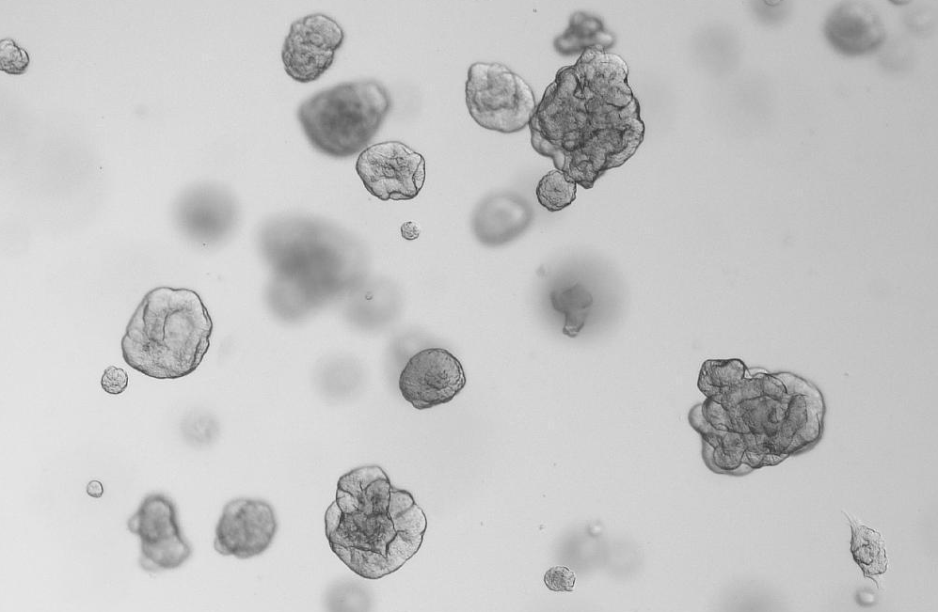
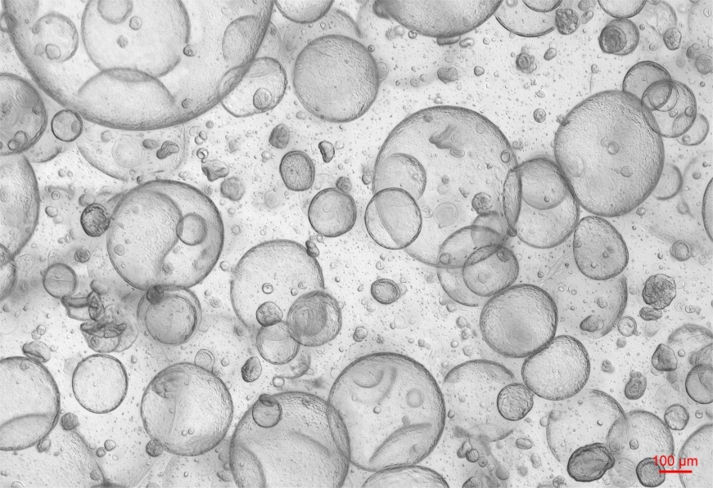
经不同类器官培养验证的细胞因子
人肾癌类器官
人肾类器官
Human kidney cancer organoids were cultured with FGF2(10014-HNAE), FGF7(10210-H07E), EGF(50482-MNCH), FGF10(10573-HNAE), NOG(50688-M02H), RSPO1(11083-HNAS). (Routinely tested). Data provided by D1 Medical Technology.
Human kidney organoids were cultured with FGF7(10210-H07E), EGF(50482-MNCH), FGF10(10573-HNAE), NOG(50688-M02H), RSPO1(11083-HNAS), HGF(10463-HNAS), FGF4(16043-HNAE). (Routinely tested). Data provided by D1 Medical Technology.
义翘神州

Slide 30
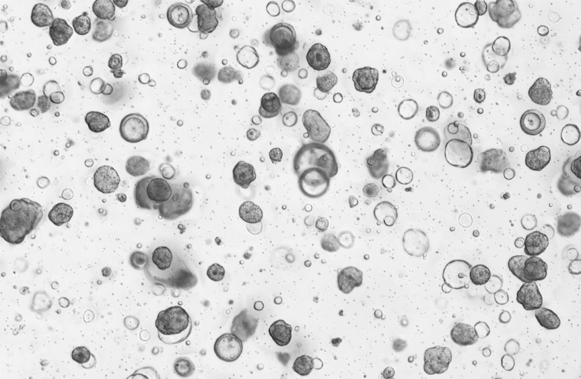
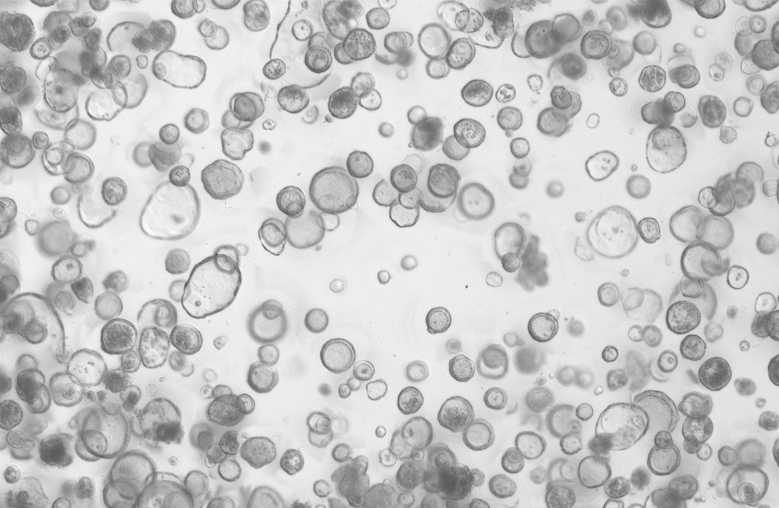
经不同类器官培养验证的细胞因子
人胃癌类器官
人胃类器官
Human gastric cancer organoids were cultured with EGF(50482-MNCH), FGF10(10573-HNAE), NOG(50688-M02H), RSPO1(11083-HNAS). (Routinely tested). Data provided by D1 Medical Technology
Human stomach organoids organoids were cultured with EGF(50482-MNCH), FGF10(10573-HNAE), NOG(50688-M02H), RSPO1(11083-HNAS). (Routinely tested). Data provided by D1 Medical Technology.
义翘神州

Slide 31
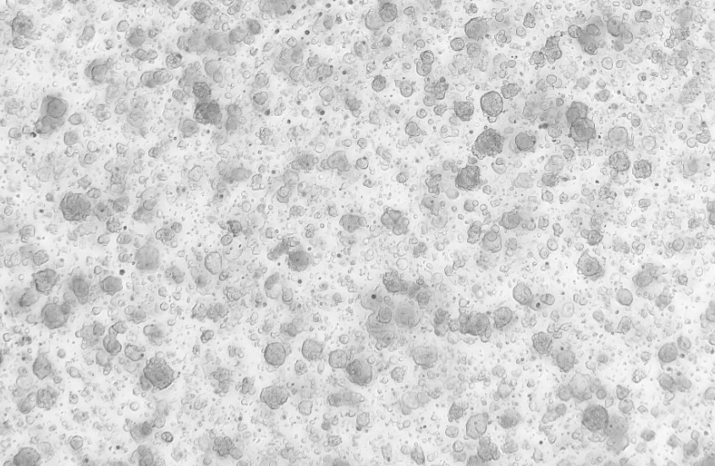

经不同类器官培养验证的细胞因子
人卵巢癌类器官
人小肠类器官
Human ovarian organoids were cultured with IGF1(10598-HNAE), NRG1 Beta 1(11609-H01H), RSPO1(11083-HNAS), EGF(50482-MNCH), NOG(50688-M02H). (Routinely tested). Data provided by D1 Medical Technology.
Human small intestinal organoids were cultured with IL22(13059-HNAE), FGF10(10573-HNAE), EGF(50482-MNCH), NOG(50688-M02H). (Routinely tested). Data provided by D1 Medical Technology.
义翘神州

Slide 32
类器官培养相关细胞因子产品(部分)
货号 | 分子 | Intestinal | Gastric | Liver | Lung | Breast | Brain | Heart | Pancreatic | Prostate
10605-HNAE | EGF | ✓ | ✓ | ✓ |  | ✓ |  |  | ✓ | ✓
10014-HNAE | FGF2 |  |  | ✓ | ✓ | ✓ | ✓ | ✓ | ✓ | ✓
10210-H07E | FGF7 |  |  |  | ✓
10804-HNAC | TGFB1 |  |  | ✓
10573-HNAE | FGF10 |  | ✓ | ✓ | ✓ | ✓ |  | ✓ | ✓ | ✓
10267-HNAH | NOG | ✓ | ✓ | ✓ | ✓ | ✓ | ✓ |  | ✓ | ✓
10429-HNAH | INHBA |  |  | ✓ | ✓ |  |  | ✓ |  | ✓
10463-HNAS | HGF |  |  | ✓
11083-HNAS | RSPO1 | ✓ | ✓ | ✓ | ✓ | ✓ |  |  | ✓ | ✓
10452-HNAH | OSM |  |  | ✓
10170-H08H | DKK1 |  |  | ✓ |  |  | ✓
10561-HNAE | GDNF |  |  |  |  |  | ✓
14890-HNAH | LIF |  |  |  |  |  |  | ✓
16043-HNAE | FGF4 |  |  |  |  |  | ✓
10609-HNAE2 | BMP4 |  |  |  |  |  | ✓
WNT007-02H | Wnt Surrogate | ✓ | ✓ | ✓ | ✓ |  | ✓ | ✓ | ✓
义翘神州

Slide 33









坚持自主研发生产
打造中国生命科学研究“一站式”试剂与服务支撑平台
现货供应
9,000 +
重组蛋白
14,000 +
精品抗体
49,000+
基因产品
ELISA 试剂盒、培养基、
GMP级核酸酶等特色产品
人才与设施
荣誉资质
设施：
---超2,0000平米研发中心
---超5,000平米洁净车间
团队：近1000人
--- 硕士以上学历占1/3
--- 30+ 欧美深造经历
义翘神州
Notes:
北京义翘神州科技股份有限公司，是国内蛋白、抗体研发生产专家，专注于为生命科学研究和创新药物研发领域提供全面、高质量的重组蛋白和抗体等生物试剂及专业、一站式的技术服务。
公司总部位于北京，是国家高新技术企业。目前已在美国、欧洲、日本，以及上海、广州、泰州、苏州等地设有分、子公司，产品销往90多个国家和地区。
公司目前建立有重组蛋白、抗体、基因产品库，以及ELISA试剂盒、培养基、转染试剂、GMP级核酸酶等产品的研发与生产，现货产品近7万种。
同时，建立有从基因克隆、蛋白表达、抗体开发与生产到质量控制研究在内的一站式CRO技术服务平台，推进客户研发进程。

Slide 34

感谢观看！
北京义翘神州科技股份有限公司
地址：北京市经济技术开发区科创十街18号院9号楼
电话：400-890-9989
网址：cn.sinobiological.com
邮箱：order@Sinobiological.com
义翘神州

