Slide 1
第八节 冠词
01
考点解读
考点梳理
02
03
真题剖析
04
实战提分

Slide 2
考点解读
01

Slide 3
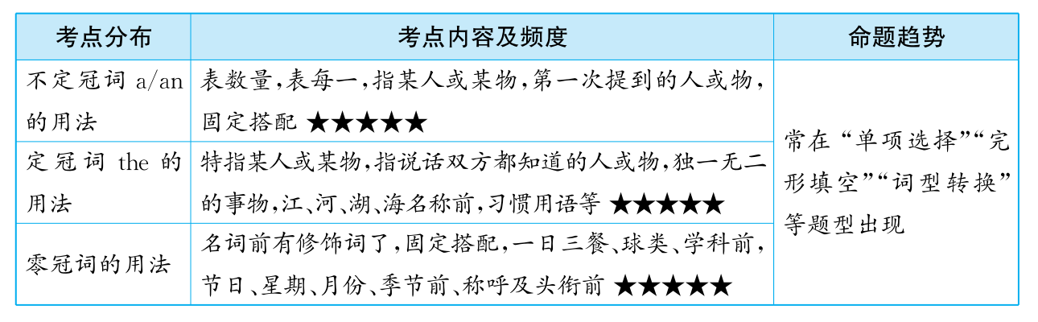

Slide 4
考点梳理
02

Slide 5
（一）冠词的概述和分类 ★★★
冠词是一种虚词，不能单独作句子成分，要放在名词之前用来帮助说明名词所指的含义。冠词可以分为两种：一种是不定冠词a，an;另一种是定冠词the。
1. 不定冠词一般放在单数可数名词之前。a用于以辅音音素开头的单词前，an用于以元音音素开头的单词前，注意不是以元音字母开头，因为有些以元音字母开头的单词并不以元音发音。如：a boy，a desk，a university，an“M”，an apple, an hour, an 8yearold boy。

Slide 6
（一）冠词的概述和分类 ★★★
2. 定冠词既可用于可数名词的单复数前，又可用于不可数名词之前，表示特指。如： the boy这个男孩，the books这些书，the food这些食物。

Slide 7
（二）冠词的用法 ★★★★★
1. 不定冠词a，an的基本用法 ★★★★★
用法 | 例句或例词
表示数量“一”的概念 | I have a computer. This is an old picture.
表示“每一”的概念 | I go to the cinema once a month. (a month=every month)
指某人或某物，但不具体说明何人何物，表示的是一类人或事物 | A reporter wants to see you. A man is waiting for you downstairs.
第一次提到某人或某物时要用不定冠词 | There is an old man under the tree. The man is our headmaster.
用于某些固定搭配中 | a lot, a lot of, a few, a bit, a pair of, a moment, have a good time, in a hurry, at a time, have a rest

Slide 8
（二）冠词的用法 ★★★★★
2. 定冠词the的基本用法 ★★★★★
用法 | 例句或例词
特指某（些）人或某（些）事物 | The girl in red is Lucy. The capital of China is Beijing.
指说话双方彼此都知道的人或事物 | Please pass me the pen. Where did you find the knife?
指上文提到的人或事物 | Tomorrow we'll have a meeting and the meeting will begin at eight.
用在世界上或一定范围内独一无二的事物前 | the sun, the earth, the sky, the universe The earth goes round the sun.

Slide 9
（二）冠词的用法 ★★★★★
2. 定冠词the的基本用法 ★★★★★
用法 | 例句或例词
用在序数词、形容词最高级及方位名词前 | the first, the heaviest, in the west, in the north China is one of the biggest countries in the world.
“the+形容词”可表示“某一类人” | the young, the old, the poor, the rich We should help the poor.
用在江河、湖泊、海洋、山脉、群岛的名称前 | the Yellow River, the West Lake
用在一些习惯用语中 | in the morning, in the future, in the evening, by the way, in the daytime

Slide 10
（二）冠词的用法 ★★★★★
3. 零冠词（不用冠词）的主要用法 ★★★★
(1)零冠词就是不用冠词。一般来说，不可数名词和可数名词用复数表示泛指时不用冠词。如：They are students.
(2)名词前已有this, that, my, your, his, her, their, our, some, any等修饰语时。如：This book is very interesting.

Slide 11
（二）冠词的用法 ★★★★★
(3)在某些固定搭配中。如：by bus, by plane, by air, by sea, on foot, at home, at night, at noon, go to school, go to bed。
(4)在一日三餐、球类运动和学科名词前。如：have breakfast，have lunch，have dinner，play basketball，play football，study English。

Slide 12
（二）冠词的用法 ★★★★★
(5)在节日、星期、月份、季节等名词前。如：Teachers' Day，on Monday，in March，in winter。
(6)在称呼语或表示头衔的名词前。如：Mr Green，Uncle Wang，Dad，Mum。

Slide 13
真题剖析
03

Slide 14
真题链接
【例1】—How often do you play tennis?
—Twice week. And I often play it in ____sports center in our school.
A. the;／ B. a; an
C. an; the D. a; the
✓
【解析】考查冠词。句意：“你多久打一次网球？”“一周两次。我经常在学校的操场打球。”其中，a表示“一个”，放在以辅音音素开头的单词前面；an表示“一个”，放在以元音音素开头的单词前面；the表“这个”，是特指。根据“in our school”是介词短语，修饰sports center，也就是特指我们学校的运动场。故答案选D。

Slide 15
真题链接
【例2】Carols uncle has egg and some bread for his breakfast every morning
A. a B. an
C. the D. /
✓
【解析】考查冠词an。an表示“一个”，用于以元音音素开头的单词前面。egg鸡蛋的第一个发音是/e/，为元音音素。故答案选B。

Slide 16
真题链接
【例3】—Do you know how to spell word “napkin”?
—Yes. It begins with “n”
A. the; a B. the; an
C. a; the D. the; the
✓
【解析】句意：你知道如何拼写napkin(纸巾)这个单词吗？这里表示特指，用定冠词the。该单词以字母“n”开头，读音是/en/，为元音音素，用an。故答案选B。

Slide 17
真题链接
【例4】Yao Ming is excellent basketball player.
A. a B. an
C. the D. /
✓
【解析】 excellent以元音音素开头，其前面不定冠词用an。故答案选B。

Slide 18
真题链接
【例5】Give me book next to the TV set and I also need ____pencil.
A. a; the B. the; a
C. the; the D. a; a
✓
【解析】the表示特指，指挨着电视机的那本书。第二个设空处则表示泛指，因此答案选B。

Slide 19
易错剖析
【例1】Tom is honest boy, we all love him.
A. a B. an
C. the D. /
✓
【解析】通常不定冠词a用在以辅音音素开头的单数可数名词前，an用在以元音音素开头的单数可数名词前。判断一个单词是以元音音素开头还是以辅音音素开头，要根据其读音，而不是根据其字母。单词honest的第一个读音是元音，但多数学生认为h是辅音字母，容易用不定冠词a来修饰。故答案选B。

Slide 20
易错剖析
【例2】—Can you play piano?
—Yes, I can
A. a B. an
C. the D. /
✓
【解析】演奏乐器前要用定冠词the来修饰。故答案选C。

Slide 21
易错剖析
【例3】—What do you like best?
—I like playing basketball best.
A. a B. an
C. the D. /
✓
【解析】在此题中，只要学生记住了下面的口诀，就知道了本题的答案。
下列情况不用冠词：
球类、学科和三餐，专有名词不可数，星期月份季节前，交通手段和节日，习俗称谓和头衔。所以答案为D。

Slide 22
实战提分
04

Slide 23
基础过关
写出下列短语的英文表达。
1. 一只盒子 2. 一块手表
3. 太阳 4. 第一
5. 长江 6. 年轻人
7. 早上 8. 白天
9. 许多 10. 一双
a box
a watch
the sun
the first
the Yangtze River
the young
in the morning
in the daytime
a lot of
a pair

Slide 24
拓展提升
单项选择。从下列每小题所给的选项中，选出可以填入空白处的最佳选项。
1. （2020年上海)Kelly's cheese cakes were sold out within half ____hour at the night market.
A. a B. an C. the D. ／
2. （2020年青岛）What unusual school trip we had! I will never forget it.
A. a B. an C. the D. ／
✓
✓

Slide 25
拓展提升
3. （2020年哈尔滨）—Candy, I have a toothache. What should I do?
—You'd better see a dentist and get X-ray.
A. an B. a C. ／
4. （2020年株洲)My little brother, eight-year-old boy, is very bright.
A. a B. an C. the
✓
✓

Slide 26
拓展提升
5. （2020年湘西)I enjoy having breakfast with my family at home. It makes me feel relaxed.
A. a B. the C. /
6. （2020年温州）I have dog. His name is Floppy.
A. a B. an C. the D. ／
✓
✓

Slide 27
拓展提升
7. （2020年恩施）I got a nice gift from my aunt and_______
gift was a souvenir（纪念品）from her study tour in England.
A. 不填 B. a C. the
8. （2020年天津）Lao She was great writer. He was especially famous for play Teahouse.
A. An; the B. a; the
C. an; a D. a; an
✓
✓

Slide 28
拓展提升
9. （2020年滨州）—Have you ever seen film Ne Zha.
—Yes, I have. It tells us different story of Ne Zha.
A. a; an B. an; the
C. a; the D. the; a
10. （2020年益阳) I read unusual story last night.
story is about Dr. Zhong Nanshan.
A. an; A B. a; The C. an; The
✓
✓

Slide 29
拓展提升
11. （2020年黔西南州）Beijing， capital of China，is ______
city with long history.
A. the; the B. a；a
C. the; a D. ／；the
12. （2019年沈阳）Paper is useful invention. Cai Lun invented it around 2，000 years ago.
A. a B. an
C. the D. 不填
✓
✓

Slide 30
拓展提升
13. （2019年上海）Benjamin has learned that it is not polite to make fun of others.
A. a B. an
C. the D. /
14. （2019年莱芜区）—Have you ever seen new movie，The Wandering Earth（《流浪地球》）？
—Yes，and Wu Jing is my favorite actor.
A. a B. an C. the D. /
✓
✓

Slide 31
拓展提升
15. （2019年黑龙江）My cousin bought useful book for me， but I've read book before.
A. a; the B. an; a
C. an; the D. a; a
✓

