Slide 1
Unit 7 It’s raining!
Section A 3a-Self Check
R·七年级下册

Slide 2
Learning objects
By the end of the class, you will be able to …
1. Learn curriculum words and useful expressions.
2. Write a postcard when you are traveling.
3. Enjoy and share the beautiful scenery and
interesting things with your friends.

Slide 3
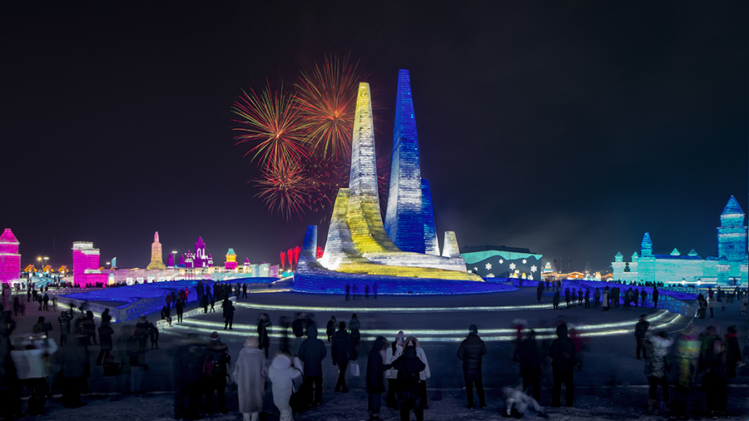
Free talk
Kate is on a vacation. She takes some pictures. Can you get some information from pictures?
What city is there?
Harbin

Slide 4
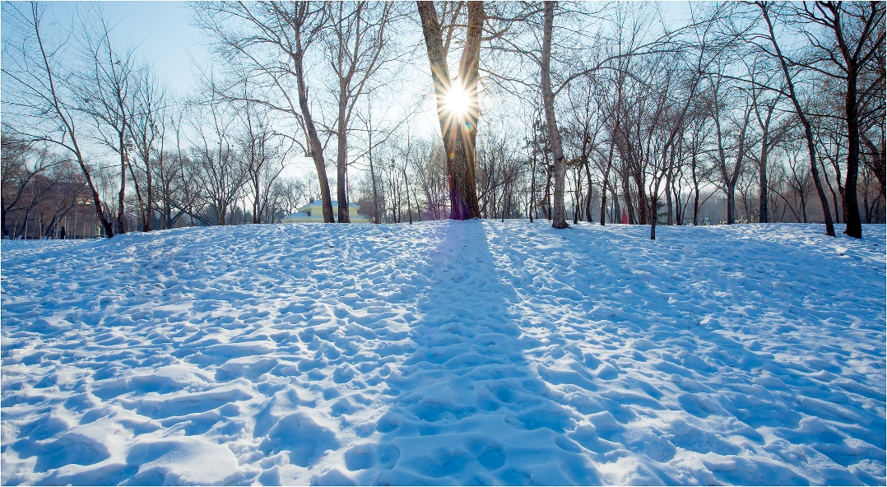
How’s the weather?
Cold and snowy.

Slide 5
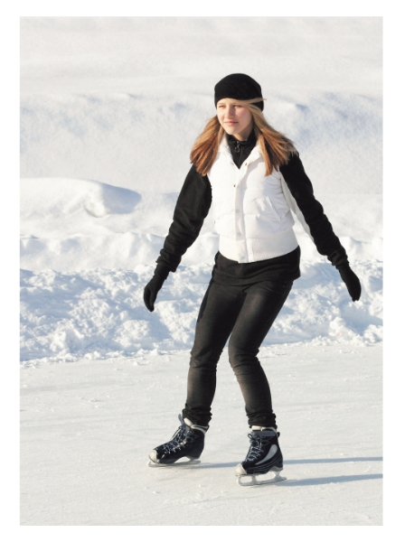
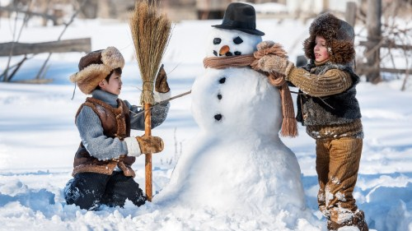
What are they doing?
skating on the river
making a snowman

Slide 6
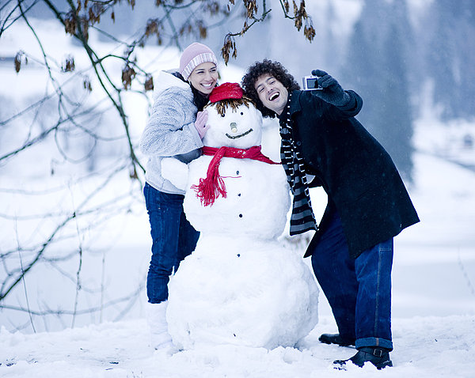
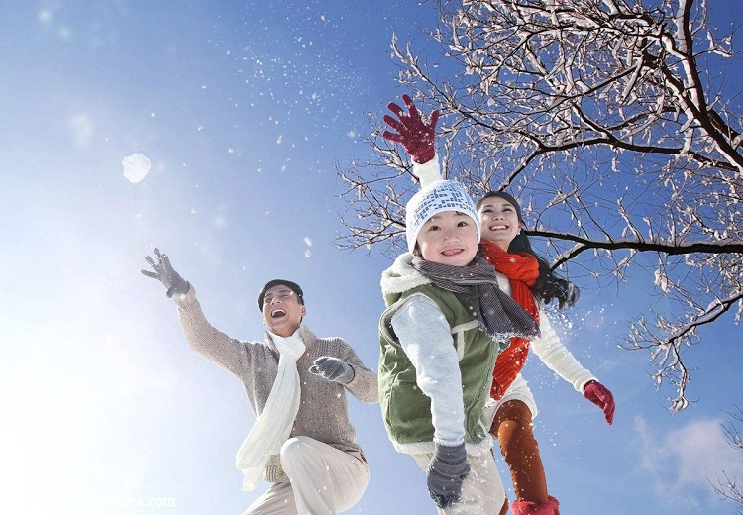
What are they doing?
taking picture
playing in snow

Slide 7
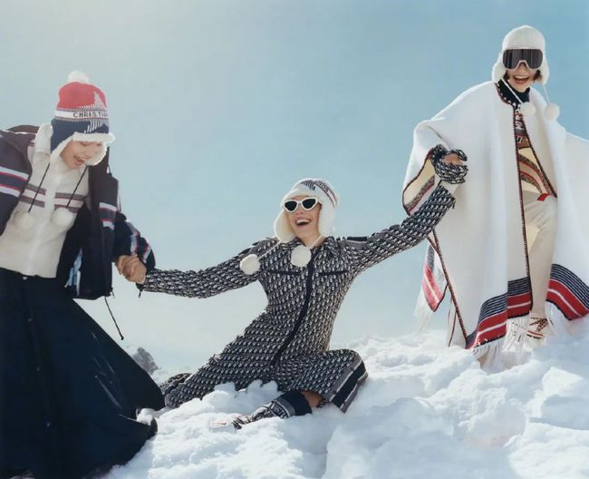
How is she feeling?
have a great time
happy
relaxed

Slide 8
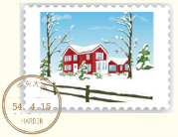
3a
Fill in the blanks with the words in the box.
skating buying playing
taking snowy windy
Dear Xiao Lu,
It’s winter in Harbin. The weather is ______ and _______. People are wearing hats and sweaters, but they’re having fun.
windy
snowy

Slide 9
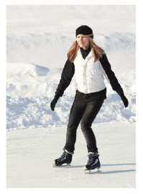
skating buying playing
taking snowy windy
Friends are _______ Russian bread to take home.
In a park, some boys are _______ in the snow. One girl is _______ on a river and a man is _______ a photo of a snowman.
I miss you.
Kate.
buying
playing
skating
taking

Slide 10
What kind of information is mentioned in this passage?
weather
special food
vacation
feelings
clothes
people
activities

Slide 11
3b
Imagine you are on vacation. Write notes about your vacation.
  Where are you?
  What’s the weather like?
  What are you doing right now?
  What are your friends or family doing?
  Are you having a good time?

Slide 12
I’m on a vacation in Beijing. We’re on the
Great Wall right now.
The weather is cloudy and cool.
I’m talking to some students from the US.
My father is taking some photos of the mountains.
My mother is taking a walk.
My sister is drawing a picture.
My vacation is great.

Slide 13

Write a postcard to a friend. Tell your friend about your vacation and what you are doing.
3c

Slide 14
Dear Mike，
How’s it going? Are you still busy with school or are you on vacation now?
I’m visiting my uncle in Qingdao and having a wonderful time here. Qingdao is a beautiful city and the weather here is warm and sunny now. There are many things to do here. Right now I’m playing with my uncle’s family at the beach.
Amy

Slide 15
Let’s write
假如你是玛丽，你和你的家人正在山里过暑假，请根据下列图片及文字提示，给你的朋友吉娜写一封信，介绍一下你们此刻的度假情况。
1. 这里总是晴天，但天气并不热，正适合游玩；
2. 妈妈正和妹妹玩，我在给你写信，爸爸在拍照；
3. 这是个令人放松的地方，我们玩得非常开心。
要求:1.要点齐全，可适当发挥；
2. 结构完整，表达通顺，语言规范，书写工整；
3. 不少于60词(开头和结尾已给出,不计入总词数)。

Slide 16
Dear Gina,
How’s your summer vacation going? _______
_______________________________________
_______________________________________
_______________________________________
See you soon.
Mary

Slide 17

谋篇布局
开篇点题
I’m on a vacation with … in the ...
It’s always…, but the weather is not…
Right now, we are having a great time…
My mother is… I’m…
What’s my father doing? He’s…
描述天气及正在做的事情
It’s a really relaxing place and we have great fun.
表达感想

Slide 18

积句成篇
summer vacation 暑假
on (a) vacation 度假
right now 此刻；马上
have fun 过得愉快
play with sb. 和某人玩耍
have a good/great time 玩得开心
短语储备

Slide 19
write to sb. 给某人写信
in the mountains 在山里
just right for… 正好适合……
take a photo of sb./sth. 给某人/某物拍照

Slide 20
句型荟萃
开头句
How’s it going? 近来可好？
My family and I are on a vacation in… 我和家人在……度假。
I’m on a vacation with… 我正和……度假。

Slide 21
中间句
The weather is… in… ……的天气……
… am/is/are doing sth. ……正在做某事。
Some people are... and some are...
一些人在……还有一些在……
Now/Right now… are having a great/good time…
此刻……正玩得开心……
We’re happy to do sth. 我们很高兴做某事。

Slide 22
结尾句
We all feel very happy. 我们都感到非常高兴。
We are having fun. 我们玩得很开心。
It’s a really relaxing place. 这里真是一个令人放松的地方。

Slide 23
范文赏析
Dear Gina,
How’s your summer vacation going? I’m on a vacation with my family in the mountains. It’s always sunny here, but the weather is not very hot, just right for visiting. Right now, we are

Slide 24
having a great time playing outside. My mother is playing with my sister. I’m sitting by a tree and writing to you. What’s my father doing? He’s taking photos of us. It’s a really relaxing place and we have great fun.
See you soon.
Mary

Slide 25
Self check
1 Add more words in each box.
Feelings | great,
Weather | cool,
Activities | playing ping-pong,
good, not bad, terrible
cold, warm, hot, dry, windy, cloudy, rainy, snowy, sunny
going to the movie, visiting my aunt, drinking orange juice

Slide 26
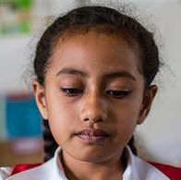
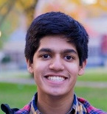
Pair work
Use the words in the box to make a dialogue.
Hi, Peter! Where are you?
I’m in Harbin.
How’s it going?
Pretty good.
What are you doing there?
…

Slide 27
2 Match the sentences on the left with the responses
on the right.
B: Thank you. Bye.
B: Hi, Jenny. It’s Steve
here. May I speak to
Laura, please?
B: Yes. Could you ask her
to call me at 8765-4321?
A: Hello? Jenny speaking.
A: Sorry, she’s not at home.
Can I take a message?
A: Sure, no problem.

Slide 28
3 Put these sentences in order to make a
conversation. Then write your own conversation.
____ It’s raining and very cool.
____ What are you doing in the rainy weather?
____ Not too bad.
____ How’s the weather in Nanjing?
____ I’m reading a book in my room.
____ Hi, Jill! How’s it going?
4
5
2
3
6
1

Slide 29
Summary
How to talk about your vacation
weather
special food
vacation
feelings
clothes
people
activities

Slide 30
Homework
Review the key knowledge.
Write a postcard or letter to your friends to talk about the weather, activities, and so on in your traveling.
Do the exercises.（见“状元成才路”系列丛书《创优作业》对应课时作业。）

